Slide 1
The Lower–Risk Cannabis Use Guidelines (LRCUG)

Slide 2
All rights reserved © Centre for Addiction and Mental Health, 2019. These slides are based on the LRCUG, an evidence-based intervention project, are supported by the Canadian Research Initiative in Substance Misuse (CRISM) and the Public Health Agency of Canada (PHAC). This material may not be altered, adapted or copied without the express written permission of CAMH.
Original source: Fischer, B., Russell, C., Sabioni, P., van den Brink, W., Le Foll, B., Hall, W., Rehm, J., & Room, R.,(2017). Lower-Risk Cannabis Use Guidelines (LRCUG): An evidence-based update. American Journal of Public Health, 107(8). DOI: 10.2105/AJPH.2017.303818.
Disponible en francais

Slide 3
3
Overview
1
2
3
Background
Lower-Risk Cannabis Use Guidelines (LRCUG): Recommendations
Other Resources

Slide 4
4
Background
Cannabis Use
Cannabis is widely used, with 125 to 200 million cannabis users globally.
Canada has among the highest rates of cannabis use in the world, particularly among youth, along with the US and Australia.
About one in seven (14.8 percent) Canadians aged 15+ reported using cannabis in the past year (Canadian Tobacco, Alcohol and Drugs Survey, 2017).

Slide 5
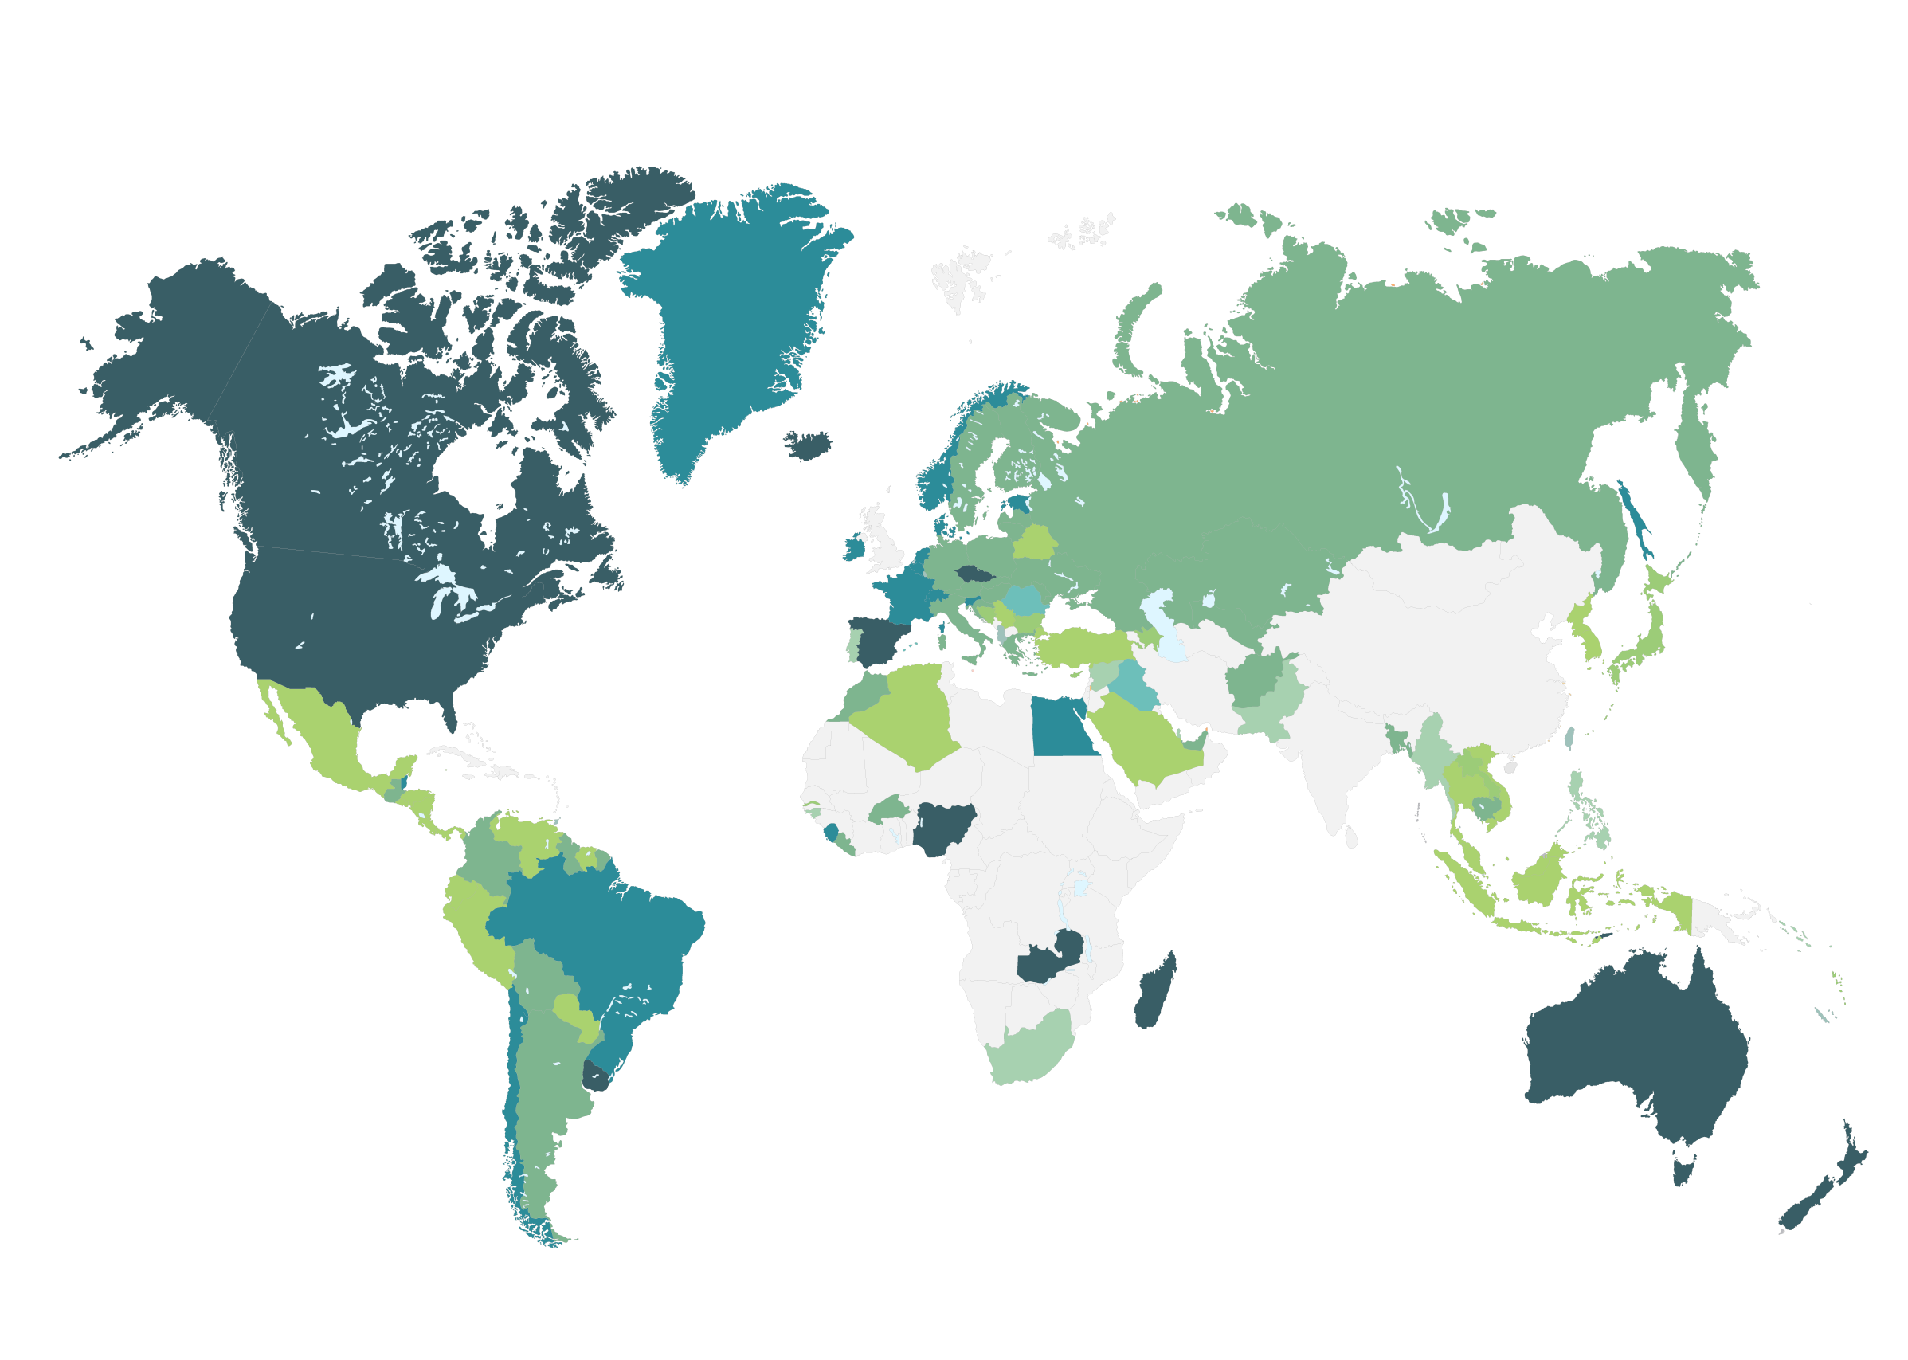
5
Background
Globally, Canada has high levels of cannabis use.
Global prevalence of cannabis use for population aged 15-64 years
PREVALENCE (%) IN 2013
<2
2-4
5-8
>8
Data not available
Source: World Drug Report 2015. United Nations Office on Drugs and Crime.

Slide 6
6
Background
Cannabis use has remained steady over the past decade.
Past Year
Lifetime
Lifetime & past year prevalence of cannabis use among Canadians ages 15+ years
Source: Canadian Alcohol and Drug Use Monitoring Survey (CADUMS; 2008-2011) and Canadian Tobacco, Alcohol, and Drugs Survey (CTADS; 2013, 2015, 2017)

Slide 7
7
Background
15-24
15-19
20-24
25+
Cannabis use trends differently, depending on age.
Past year prevalence of cannabis use among Canadians, by age group
Age groupings differed in 2008-2011 and 2013-2017 surveys
Source: Canadian Alcohol and Drug Use Monitoring Survey (CADUMS; 2008-2011) and Canadian Tobacco, Alcohol, and Drugs Survey (CTADS; 2013, 2015, 2017)

Slide 8
8
Background
Males – Lifetime Use
Males – Past Year Use
Females – Lifetime Use
Females – Past Year Use
Females consume cannabis less than males, but overall
trends in use have been steady over 10 years.
Lifetime & past year cannabis use among Canadians, by sex
Source: Canadian Alcohol and Drug Use Monitoring Survey (CADUMS; 2008-2011) and Canadian Tobacco, Alcohol, and Drugs Survey (CTADS; 2013, 2015, 2017)

Slide 9
9
Background
Cannabis use is associated with risks for several short- and long-term adverse health outcomes, including:
hallucinations, perception/memory impairment, loss of psychomotor control
mental health problems, including psychosis
cannabis use disorder (including dependence)
Injuries/collisions, including those from impaired driving
respiratory problems
reproductive/newborn health problems
These outcomes are not given consequences of cannabis use, but may occur among those who use cannabis in higher-risk ways.
Cannabis Use & Health Risks

Slide 10
10
LRCUG
The Lower-Risk Cannabis Use Guidelines are a tool aiming to reduce cannabis-related health risks among those who use or are considering cannabis use.
The LRCUG are based on the idea that health risks can be reduced through informed, evidence-based choices related to cannabis use.
The LRCUG are based on a systematic review of the scientific evidence to identify key modifiable risk factors that influence cannabis use-related health risks.
A team of scientific experts reviewed and quality-graded the evidence, and translated findings into recommendations based on expert consensus methods.
The current LRCUG were published in the American Journal of Public Health (2017).
Lower Risk Cannabis Use Guidelines (LRCUG)

Slide 11
11
LRCUG
LCRUG:
The Recommendations

Slide 12
12
LRCUG
Abstinence
RECOMMENDATION #1
The most effective way to avoid the risks of cannabis use is to abstain from use.
1
THE EVIDENCE
Anyone who uses cannabis may incur a variety of short- and/or long-term risks related to both health and social outcomes.
The likelihood and severity of these risks will vary based on individual characteristics, the product used, and patterns of use.
The risks may not be the same from person to person, or one episode of use to another.

Slide 13
13
LRCUG
2
RECOMMENDATION #2
Delaying cannabis use, at least until after adolescence, will reduce the likelihood or severity of adverse health outcomes.
Age of Initial Use
THE EVIDENCE
Cannabis users who start young, especially before the age of 16, and who use cannabis more intensely, are more likely to develop mental health or substance use problems, or to experience injuries later in life.
A contributing factor may be the impact of cannabis use on brain development, which is not completed until the mid-20s.
The younger the age of initiating cannabis use, the greater the likelihood of developing problems.

Slide 14
14
LRCUG
Choice of Cannabis Products
RECOMMENDATION #3
Use products with low THC and high CBD:THC ratios.
THE EVIDENCE
3
Cannabis products vary greatly, including tetrahydrocannabinol (THC) content, its main psychoactive ingredient. Higher THC potency is related to higher risk of adverse health outcomes (e.g. psychosis, dependence).
Average THC concentrations have been increasing to 20-25% or more in recent decades. Cannabis extracts or concentrates typically contain much higher THC levels.
Cannabidiol (CBD), another cannabis component, counteracts some of THC’s effects.
Current research evidence does not pinpoint a specific level of THC that could be categorized safe or unsafe.

Slide 15
15
LRCUG
RECOMMENDATION #4
The use of synthetic cannabis products, such as K2 or Spice, should be avoided.
4
Choice of Cannabis Products
THE EVIDENCE
Synthetic cannabinoids are a relatively new, and illegal, class of products. They have a distinct pharmacology and toxicology than natural cannabis products, including generally more severe psychoactive impacts and health risks that may lead to accidental death.

Slide 16
16
LRCUG
5
Methods & Practices
RECOMMENDATION #5
Avoid smoking burnt cannabis and choose safer inhalation methods including vaporizers, e-cigarette devices and ingestible products.
THE EVIDENCE
Persistent smoking of burnt cannabis can result in respiratory problems, possibly including lung cancer.
Alternative inhalation methods are vaporizers or e-cigarette devices. Ingested or “edible” products avoid inhalation, but their delayed onset of psychoactive effects may lead people to take higher doses.
If accompanied by adequate product labeling, packaging and warnings, edibles may offer the safest method of cannabis use.
No method of use is entirely risk-free.

Slide 17
17
LRCUG
6
RECOMMENDATION #6
If cannabis is smoked, avoid harmful smoking practices such as inhaling deeply or breath-holding.
Methods & Practices
THE EVIDENCE
Breath-holding or deep inhalation practices are intended to increase the absorption of psychoactive components and effects of cannabis.
However, these practices increase the intake of toxic materials and can heighten respiratory health risks.
These effects are further amplified when cannabis and tobacco are smoked together.

Slide 18
18
LRCUG
7
Frequency & Intensity of Use
RECOMMENDATION #7
Avoid frequent or intensive use, and limit consumption to occasional use, such as only one day a week or on weekends, or less.
THE EVIDENCE
The frequency and intensity of cannabis use are among the strongest and most consistent predictors of severe and/or long-term cannabis-related health problems.
These problems can include:
changes in brain development or functioning (especially at a younger age)
mental health problems or dependence
impaired driving and related injuries
educational outcomes and suicidality.

Slide 19
19
LRCUG
8
RECOMMENDATION #8
Do not drive or operate other machinery for at least 6 hours after using cannabis. Combining cannabis with alcohol increases impairment and should be avoided.
Cannabis Use & Driving
THE EVIDENCE
Cannabis impairs cognition, attention, reaction and psychomotor control.
The risk of a collision, including injury or death, is two- to three-times higher among cannabis-impaired drivers compared to those who aren’t impaired. Alcohol impairment further increases this risk.
Acute impairments from cannabis set in shortly after use and persist for at least 6 hours, but they vary depending on the individual and the product used.

Slide 20
20
LRCUG
9
RECOMMENDATION #9
People with a personal or family history of psychosis or substance use disorders, as well as pregnant women, should avoid cannabis use.
Special Risk Populations
THE EVIDENCE
Studies have identified subgroups of people with higher or distinct risks for cannabis-related health problems.
A substantial proportion of cannabis-related psychosis, and possibly other mental health problems (including cannabis dependence), occur among those with a personal or family history of such problems.
Cannabis use in pregnancy can increase the risk of adverse neonatal health outcomes, including low birthweight and growth reduction.

Slide 21
21
LRCUG
10
RECOMMENDATION #10
Avoid combining any of the risk factors related to cannabis use. Multiple high-risk behaviours will amplify the likelihood or severity of adverse outcomes.
Combining Risks or Risky Behaviour
THE EVIDENCE
While data are limited, combining any of the higher-risk behaviours described in these guidelines is likely to further increase the risks of adverse health outcomes from cannabis use.
For example, early-onset use involving frequent consumption of high-potency cannabis is likely to disproportionately increase a person’s risks of experiencing acute and/or chronic problems.

Slide 22
22
LRCUG
Summary
Based on the available scientific evidence, the key areas of risk reduction promising the largest impact for individual cannabis consumers and public health are:
Delaying cannabis use, at least until after adolescence.
Avoiding frequent or regular use, and limiting consumption to occasional use at most.
Avoiding high potency and high-risk cannabis products.
Not driving while impaired by cannabis.

Slide 23
23
LRCUG
Cautions & Conclusion
The Lower-Risk Cannabis Use Guidelines can only be effective if they are disseminated and communicated effectively, which also requires tailoring the way content is delivered to different target audiences.
The LRCUG are not a clinical guideline or substitute for treatment.
People who are experiencing problems related to their cannabis use should seek the help of a qualified health professional.

Slide 24
24
Other LRCUG Resources*
LRCUG Evidence Brief
A 4-page evidence summary, mainly for health professionals.
LRCUG Poster & Postcard
A poster and postcard presenting the LRCUG’s recommendations, in summary form. https://www.camh.ca/-/media/files/pdfs---reports-and-books---research/canadas-lower-risk-guidelines-cannabis-poster.pdf
LRCUG Brochure
A brochure for cannabis consumers. https://www.camh.ca/-/media/files/pdfs---reports-and-books---research/canadas-lower-risk-guidelines-cannabis-pdf.pdf
Youth Booklet
A youth version of the LRCUG, developed by youth at CAMH’s McCain Centre for Child, Youth and Families. https://www.camh.ca/en/health-info/guides-and-publications/lrcug-for-youth
*All materials are available in English and French

Slide 25
25
Endorsements
The LRCUG have been endorsed by the following Canadian organizations. The LRCUG have also been endorsed by the Provincial Governments of Ontario and Quebec.
Council of Chief Medical Officers of Health (CCMOH)

Slide 26
26
Reference
Fischer, B., Russell, C., Sabioni, P., van den Brink, W., Le Foll, B., Hall, W., Rehm, J. & Room, R. (2017). Lower-Risk Cannabis Use Guidelines (LRCUG): An evidence-based update. American Journal of Public Health, 107(8). DOI: 10.2105/AJPH.2017.303818.
Acknowledgement
The Lower-Risk Cannabis Use Guidelines (LRCUG) are an evidence-based intervention initiative by the Canadian Research Initiative in Substance Misuse (CRISM), funded by the Canadian Institutes of Health Research (CIHR).

